Slide 1
COPADS
2022 – IFEOLUWATAYO IGE
#2 - Computer organization

Slide 2
OUTLINE
Parts of a Computer
Multicore, Multiprogramming, Multitasking
The Operating System Functions

Slide 3
Parts of a Computer
Memory – Temporary Storage for program and its data
It’s volatile – will be erased when the computer resets
It’s fast
CPU – Central Processing Unit
‘Core’
Executes the Instructors Provided by the user
I/O – Interfaces between the computer and the outside word
Generally slow

Slide 4
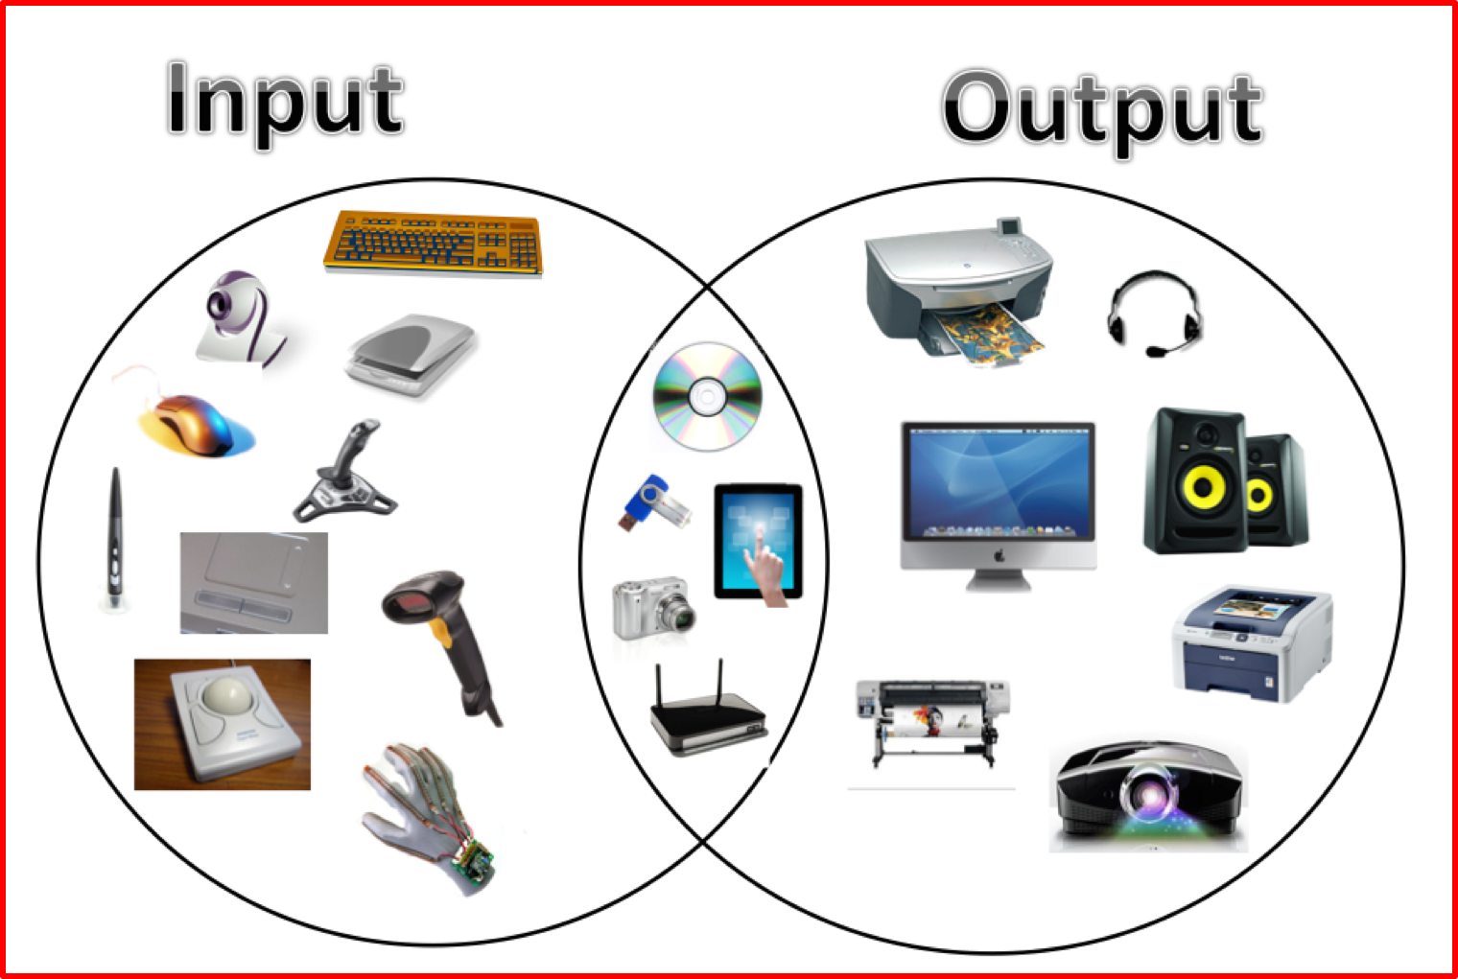
I/O Devices
Varied – Can be any number of devices that you can think of
Keyboard
Hard Drive
Graphics Card
Network
USB Stick

Slide 5
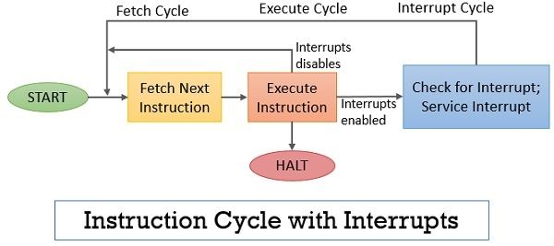
Interrupts
Interrupt the current flow of the application
caused by a hardware device (pressing a key on a keyboard)
These are asynchronous events
Once the interrupt is generated, the PIC (Programmable Interrupt Controller) will process it and pass the information to the CPU for Handling

Slide 6
Traps
Traps are caused by software
Synchronous; blocks all processes until operation is completed
When in user space, causes a switch to kernel space
When in kernel space, you get a BSOD
Generally not different than a procedure call
Examples: -An exception is a good example of this; invalid memory access, division by zero could trigger a trap
Notes:
A BSOD is a full system failure at the Windows kernel level

Slide 7
Storage Hierarchy
Registers
Cache
Main Memory
Removable Media
Solid State Drive
Rotational Disk

Slide 8
Registers
Live on the CPU
very fast
Used to pass information to the CPU (usually on an interrupt), or on a function all
Intel i7 processors have 16 registers in 64 bit mode, 8 in 32 bit mode
DISCUSSION: categories/types of registers and their functions

Slide 9
Cache
Multiple levels of Exist – often 2or 3
Usually there is an instruction and data cache
Level 1 is closest to the CPU
Smallest
Fastest
Often built in to the CPU
Level 2 (or 3) would be the last level of cache before main memory
Gets bigger (and slower) as the cache level goes up

Slide 10
Main Memory
Slower than the cache, but much larger
Typically 4GB – 64GB (can be much larger or some systems)
Has much larger latency than Cache
Cache is checked first before retrieving from main memory
Data/instructions that are frequently used will be in the cache
Last level of volatile memory

Slide 11
Solid State Drives (SSD)
Use NAND memory (maintains state after it’s power off/does not require power)
Is a block storage device
No moving parts
Limited number of writes (usually in the 500TB range)
Expensive
Relatively fast
Up to 4TB in size
DISCUSSION: - Can we affirm that SSDs and HDDs mean the same.
- Any differences?
- Pros and Cons
Notes:
1. SSDs replace traditional hard disk drives (HDDs) in computers and perform the same basic functions as a hard drive.
2. NAND is a type of flash memory that reduces erase and write times lower than hard drive,

Slide 12
Rotational Disk
Uses magnetic storage
Has spinning mechanism
Typically at 5400-15,000 RPM
Faster spinning means the head can get over the data faster, thus read faster
Up to 12TB in size
More cost effective and longer life than SSDs
Slower than SSDs

Slide 13
Removable Media
CD/DVD/Blu-Ray/Tapes
Allow for offsite storage
Much slower than drives
Typically do not have the issues of lifetime that other components have
Used for backups
DISCUSSION:
The memory hierarchy vis-a-vis characteristics and functionalities

Slide 14
Software (Levels of Program Code)
High-level language
Level of abstraction closer to the problem domain
Provides for productivity and portability
Assembly language
Textual representation of instructions
Machine representation
Binary digits (bits)
Encoded instructions and data

Slide 15
Software
Compiler
Assembler
Application software,
a program in any language:
swap (int v[ ], int k)
{int temp;
temp = v[k];
v[k] = v[k+1];
v[k+1] = temp;
}
MIPS compiler output,
assembly language program:
swap;
muli $2, $5, 4
add $2, $4, $2
lw $15, 0 ($2)
lw $16, 4 ($2)
sw $16, 0 ($2)
sw $15, 4 ($2)
jr $31
MIPS binary machine code:
00000000101000010000000000011000
00000000000110000001100000100001
10001100011000100000000000000000
10001100111100100000000000000100
10101100111100100000000000000000
10101100011000100000000000000100
00000011111000000000000000001000

Slide 16
Instruction Pipeline (IP)
The processor reads consecutive instructions from memory while other segments handle the previous instructions are being implemented.
It has three phases: Fetch, Decode, Execute
The processor initially fetches or reads the instruction from memory. The instruction is fetched from the memory address in the PC(Program Counter) and stored in the IR (Instruction Register).
At the end of the fetch operation, PC is incremented by 1 and it then points to the next instruction to be executed.
uses a first-in, first-out (FIFO) buffer.

Slide 17
Instruction Pipeline (Cont’d)
Then it decodes the instruction determining which instruction it has fetched.
Finally, it performs the operations necessary to execute the instruction.

Slide 18
Multicore CPUs
More than one CPU in the single chip
Each CPU has it’s own L1 to (Ln-1) cache,
Each CPU may have more than one pipeline, which is hyperthreading
Pipeline is the instruction queue, which may be long
Hyperthreading allows CPU to switch to another instruction set if the current pipeline is blocked
You need to write programs to take advantage of Multicore CPUs

Slide 19
Multiprogramming
Ability for multiple programs to be scheduled to run
Originally created for batch systems
Many programs would be loaded, and when one program wanted a (slow) device, it would request data and go to the back of the execution queue
In a time sharing/interactive system, peripherals are still slow
This does not mean the system is fair (quite the contrary, actually)

Slide 20
Multitasking
executing multiple tasks or processes concurrently over a period of time.
Preemptive and cooperative multitasking are two types of multitasking.
Cooperative Multitasking
Much like multiprogramming, we have more than one process scheduled
The processes voluntarily yield control periodically or when idle or logically blocked to allow multiple applications to execute simultaneously.
Evil processes could hang the system. A malicious program can bring the entire system to a halt by busy waiting or running an infinite loop and not giving up control.

Slide 21
Preemptive Multitasking
Used in all modern operating systems
The OS can also interrupt a process that is taking too much time by initiating a context switching from the running process making use of the CPU to another process
Context Switching is happening in fractions of a second
Makes a computer appear as if it is doing more than one thing at a time
A malicious program can initiate an infinite loop, it however only hurts itself without affecting other programs or threads.

Slide 22
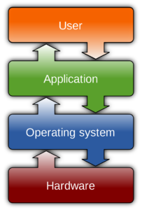
Operating system (OS)
An operating system (OS) is a program that acts as an interface between the system hardware and the user by providing an application programming interface (API) making it easier and quicker to develop code for multiple software or hardware platforms.
Also interfaces between hardware and application software

Slide 23
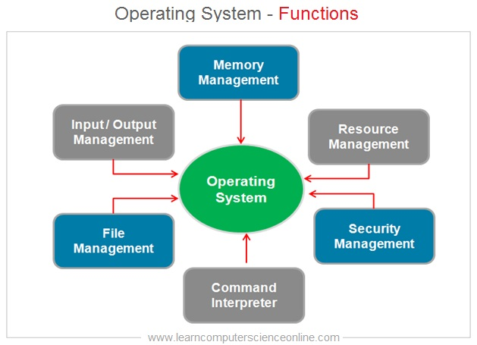

Slide 24
The OS - Process Management
Handles the scheduling of the process/threads on the CPU
Prevents a thread from having too much time
Ensures processes don’t block the UI
Process boundary
Doesn’t allow one process to access another process’s memory space
Prevents one process from accessing the resource of another one

Slide 25
The OS - Threads vs. Process
A Process is managed by the Operating system
Gets a process ID, Memory Space, Resources
May be selected by the OS to run
Thread lives inside the process
Each process has at least one thread
Thread is the instructions to execute on the CPU
All threads in a process share resources
Thread inside the Process is scheduled to run (can be managed by the OS)
With applications with only one thread, this is easy
Notes:
In Windows, each thread gets a new PID, but they still share resources

Slide 26
Algorithms for Scheduling Processes/Threads
For process scheduling, the operating system uses various algorithms:
First come first serve (non-preemptive)
Priority Scheduling
Longest job (execution time)
Shortest job (execution time)
Round robin (time sharing)

Slide 27
The OS - Inter-process Communication
Sometimes we want to allow processes to share information
Shared Memory
Two (or more processes) have a block of memory that they both can read and write from
Message Passing
Framework in the OS allows one Process to send a message to another process (much like instant messaging)
Streams
direct writing to a shared resource

Slide 28
The OS - Memory Management
Virtual Memory
Each process can allocate a contiguous block of memory, whether or not it can physically get a contiguous block of memory.
Swapping
When a process is not running, we can write its memory contents to disk (if needed)
Allows more physical memory to be available to other processes
Usually not needed in systems with a large amount of physical memory (32GB+)
Cache management
OS will create cache in available physical memory

Slide 29
The OS - Storage Management
File Systems
Disk partitioning
Format of File System
Block sizes
Permissions
Virtual Disks
Software RAID
Logical Volumes
Network Drives

Slide 30
The OS - I/O Management
Access to Peripherals
Bluetooth Devices
Network Devices
Removable Storage (USB)
Network Access
Wifi
Wired

Slide 31
The OS - GUI
Integrated into the OS
Ability to create 2D apps with OS look and feel controls
Handling of moving windows, closing, etc
On top of the OS
Gives applications their look and feel
GTK for creating GUIs
WPF (windows presentation foundation) for windows

